Slide 1
Applied Data Science Capstone project
Opening a restaurant in Amsterdam

Slide 2
introduction
Problem description
I have been asked to advice on opening a restaurant in Amsterdam. I am asked where and what kind of restaurant should be opened.
The investor has connections with several owners of restaurants and is eager to invest in a likely location for expansion.
Data description
Foursquare data is investigated to recommend a location and type of restaurant.
To be able to advice on the problem I need to find the neighborhood with the best restaurants and check what kind of restaurants there are.

Slide 3
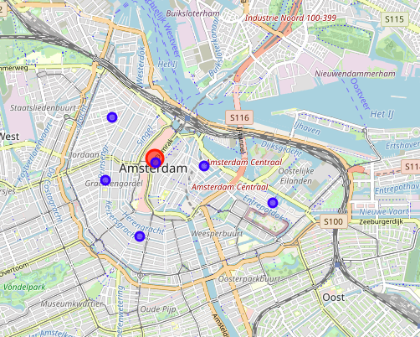
Neighborhoods in Amsterdam

Slide 4
Venues in Amsterdam
Neighborhood | Venue
Burgwallen (Oudezijde en Nieuwezijde) | 73
Lastage, Oosterdokseiland, Rapenburg, Uilenburg, Valkenburg, Waterlooplein | 40
Noordwestelijke Grachtengordel, Noord-Jordaan, Marnixplein | 100
Weesperbuurt, Plantage, Sarphatistraat, Kadijken, Oostelijke Eilanden, Czaar Peterbuurt | 40
Westelijke Grachtengordel, Zuid-Jordaan, Raamplein | 83
Zuidelijke Grachtengordel, Leidsebuurt, Weteringschans, Frederiksplein, Rembrandtplein | 69

Slide 5
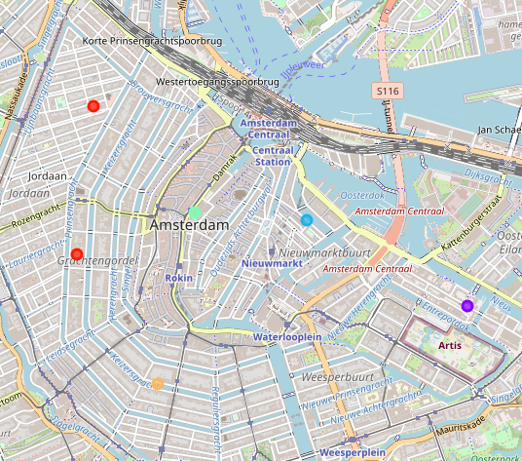
Clusters of venues

Slide 6
Conclusion
Based on the clustering we can decide that a French restaurant in ”Noordwestelijke Grachtengordel, Noord-Jordaan, Marnixplein” would be the best choice

